Slide 1

Final Presentation
WPA3-Arp Spoofing Attack
Detection and Protection Techniques
Done By:
Hilal Breiss
Sohaib El Jundi

Slide 2
So far:
Why wireless WiFi?
Protocols Used
WPA2 4-way handshake
Limitation of WPA2

Slide 3
So far:
Motivation for WPA3
Advantages of WPA3

Slide 4
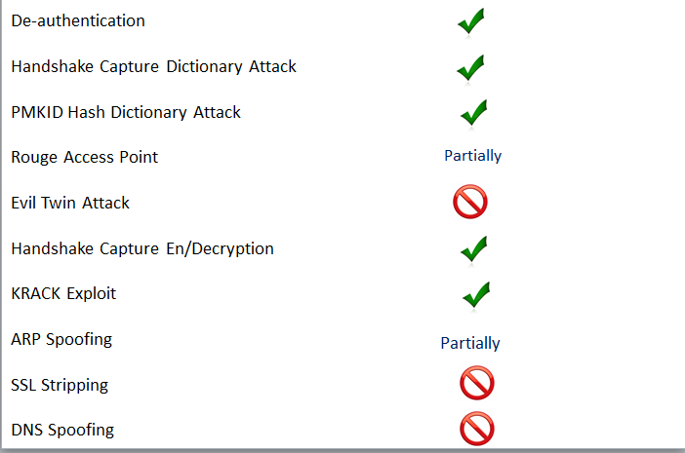
So far: WPA3 Vulnerability

Slide 5
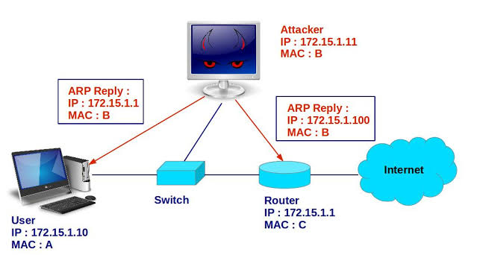
ARP Spoofing Exploit

Slide 6
We talked about one Passive Technique to detect Arp Spoofing:
Deploy gateway in the WPA3 routers one step before ARP table that act as an authentication
Next → Looking for other techniques: Passive and Active

Slide 7
Security Requirements for an Ideal Solution:
Management costs of hosts should be controlled.
The cryptographic processing, which can lower the performance of ARP, should be minimized.
Prevention and block should be detected with timely warnings, which will alert the administrator about the attack situation.
The solution has to be universal and easily applicable.
Hardware costs should be minimized.
The solution has to be compatible with ARP.
It should not slow down the ARP request/reply communications.
If possible, it should consider all the ARP attacks.
The network traffic should be contained.

Slide 8
Passive Techniques:
S-ARP:
Secure ARP extends ARP with an integrity/authentication scheme for ARP replies
Added header to carry the authentication information is introduced
S-ARP protocol will not allow non-authenticated messages to be processed unless specified.
D-ARP:
Dynamic ARP solves security problems by preventing invalid or malicious ARP packets that are delivered from the network. It identifies whether the ARP packet is valid by comparing the packet at the router, before it is delivered. If a security problem is detected, the packet is deleted
T-ARP:
The ticket-based address resolution protocol defends ARP spoofing by distributing the centrally secured IP address and MAC address mapping proof.
Looks for mismatch of the ARP request/response packet and the <IP,MAC> pair of TCP SYN.
When the information in an ARP request/response packet is different from that of the <IP, MAC>, and the TCP connection is made, ARP spoofing is assumed.

Slide 9
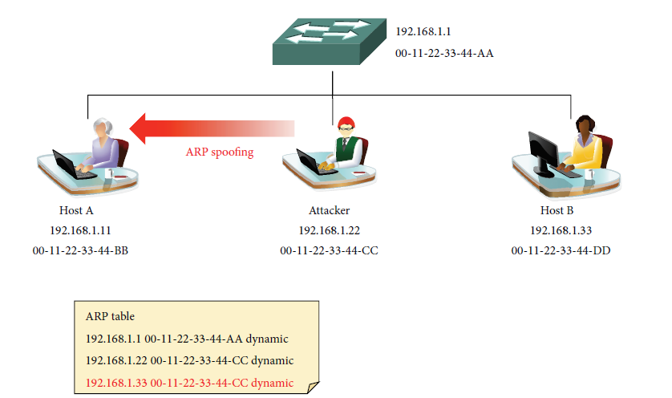
ARP cache Table periodic surveillance and Routing Trace

Slide 10
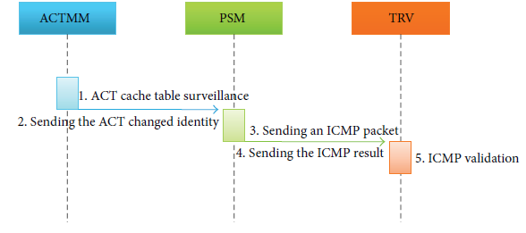
ARP cache Table periodic surveillance and Routing Trace
DS-ARP:
Detection:
periodically keeps the updated state of the ARP cache table under surveillance.
When the ARP cache table is updated, the DS-ARP performs a routing trace to identify the corresponding ⟨IP, MAC⟩ pair information
If an ARP spoofing attack is suspected, it reports to the server and initiates the protection process.
It also converts the corresponding ⟨IP, MAC⟩ pair ARP type to static mode
ACTMM: ARP cache table monitor manger
PSM: Packet send manager
TRV : Trace routing validation

Slide 11
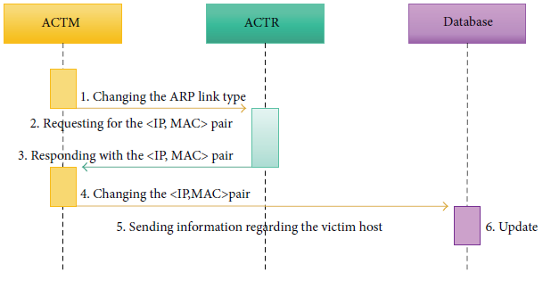
ARP cache Table periodic surveillance and Routing Trace
DS-ARP:
Protection:
After Detection is successful, pair of ARP type in the cache table changed to static mode
Restore previous entry and identify the source of the attack.
ACTM: ARP cache table manager
ACTR : ARP cache table repository

Slide 12
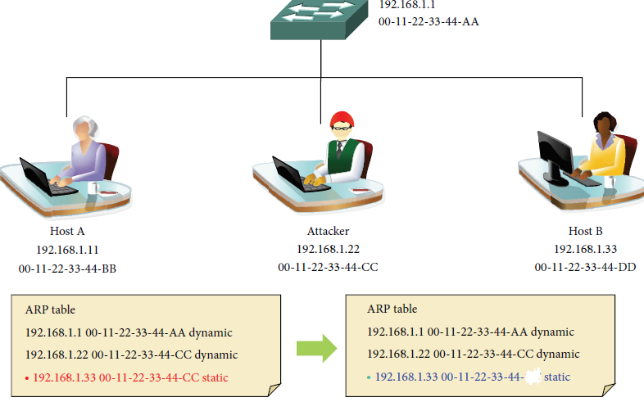
ARP cache Table periodic surveillance and Routing Trace

Slide 13
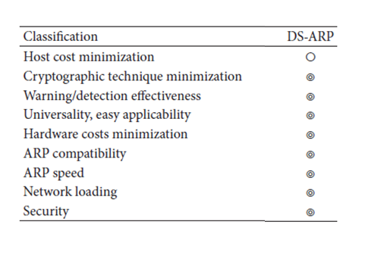
ARP cache Table periodic surveillance and Routing Trace

Slide 14
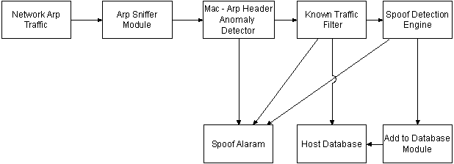
Active Technique based on TCP Response packet
Focus on Spoof Detection Engine

Slide 15
Spoof Detection Engine: How it works?
Rule A: The network interface card of a host will accept packets sent to its MAC address, Broadcast address and subscribed multicast addresses. It will pass on these packets to the IP layer. The IP layer will only accept IP packets addressed to its IP address(s) and will silently discard the rest of the packets. If the accepted packet is a TCP packet it is passed on to the TCP layer. If a TCP SYN packet is received then the host will either respond back with a TCP SYN/ACK packet
Based on Rule A:
When a TCP SYN packet is sent to the source of the ARP reply packet, the host’s response will be based on Rule A. If the ARP response was from the real host its IP stack will respond back with a TCP SYN/ACK packet.
If the ARP response had been from a malicious host then its network stack would silently discard the TCP SYN packet in accordance with Rule A. Thus based on the fact that the Spoof Detection Engine does/does not receive any TCP packets in return to the SYN packet it sent, it can judge the authenticity of the received ARP response packet.

Slide 16
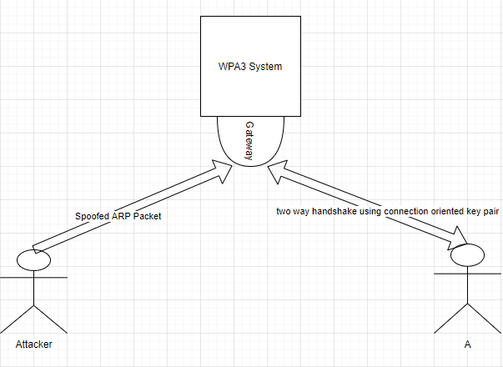
Contribution

Slide 17
Contribution
When a Host first connect to the router, a key pair is generated that is shared between the host and the router (Hard to be identified accordingly)
In normal case:
once the gateway detects an ARP packets from any source (A), the WPA3 system sends an encrypted message by the key pair generated by the connection establishment between the router and A.
Router knows it is A from the IP address sent in the ARP packet
Only A can decrypt this message using the keys
A acknowledges: I sent the ARP packet
Once Acknowledged ARP packet continue his way to be updated/added in the ARP table

Slide 18
Contribution
Easy and Simple Detection Technique
2 Approaches:
When A is not connected:
The router must first scan the network after receiving an ARP packet with the IP address of A.
If the router finds that A is not connected, it will block the ARP Packet and blocks the attacker MAC address that is available in the ARP packet.
When A is connected:
Apply the acknowledgement technique.
If acked by A, then ARP packet continues his way to the ARP table
If not acked by A, then an alarm will be raised by the router blocking the ARP packed and the MAC address shown in it.

Slide 19
References
Ramachandran V., Nandi S. (2005) Detecting ARP Spoofing: An Active Technique. In: Jajodia S., Mazumdar C. (eds) Information Systems Security. ICISS 2005. Lecture Notes in Computer Science, vol 3803. Springer, Berlin, Heidelberg
Su Song M., Dong Lee J., Jeong Y., Jeong H., Park J. (2014) DS-ARP: A New Detection Scheme for ARP Spoofing Attacks Based on Routing Trace for Ubiquitous Environments. In: Department of Computer Science and Engineering, SeoulTech, Seoul 139-743, Republic of Korea.
Zawar Shah and Steve Cosgrove, Mitigating ARP Cache Poisoning Attack in Software-Defined Networking (SDN): A Survey, Electronics, 10.3390/electronics8101095, 8, 10, (1095), (2019).Crossref
Kohlios C., Hayajneh T. (2018) A Comprehensive Attack Flow Model and Security Analysis for Wi-Fi and WPA3. In: Fordham Center for Cybersecurity, Fordham University, New York
J. Castillo-Velazquez, M. A. Garcia and D. J. S. Martinez, "Hardening as a best practice for WLAN Security Meanwhile WPA3 is released," 2019 IEEE 39th Central America and Panama Convention (CONCAPAN XXXIX), Guatemala City, Guatemala, 2019, pp. 1-5, doi: 10.1109/CONCAPANXXXIX47272.2019.8977073

